Slide 1
Severity of Accident in Seattle
Imanie Yahya

Slide 2
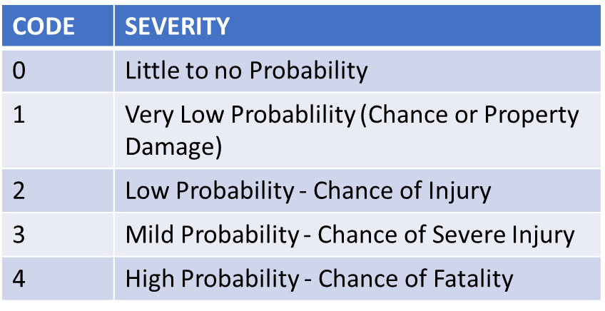
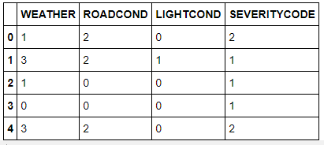

Introduction/Business Problem This project objective is to help drivers plan for their trip safely, indirectly will result in reduction on car accident frequency in a community. An algorithim will be developed to predict the severity of an accident given the weather, road and visibility conditions.
Data
Extract Dataset & Convert
Target variable for this analysis will be 'SEVERITYCODE' because it is used measure the severity of an accident from 0 to 5 within the dataset. Attributes used to weigh the severity of an accident are 'WEATHER', 'ROADCOND' and 'LIGHTCOND'.
Severity codes are as follows:
In it's original form, this data is not fit for analysis. For one, there are many columns that we will not use for this model. Also, most of the features are of type object, when they should be numerical type.
We must use label encoding to covert the features to our desired data type.

Slide 3

Balancing the Dataset
Methodology
Our target variable SEVERITYCODE is only 43% balanced. In fact, SEVERITYCODE in class 1 is nearly three times the size of class 2.
We can fix this by down sampling the majority class.
K-Nearest Neighbor(KNN)
Logistic Regression

Slide 4
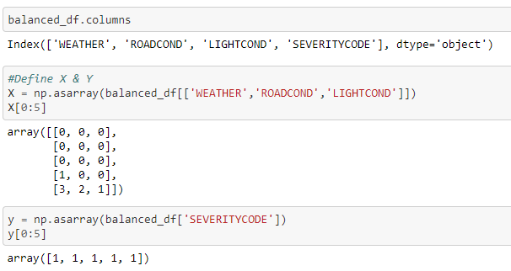
Initialization
Define X & Y

Slide 5
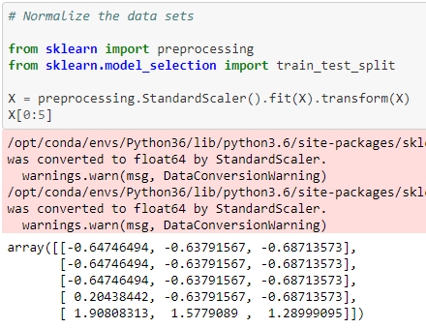
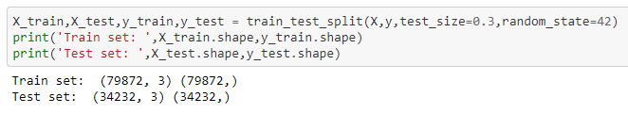
Normalize Dataset
Train/Test Split

Slide 6
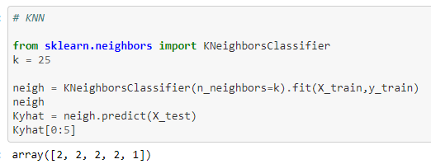
Modelling & Predictions
K-Nearest Neighbor (KNN)

Slide 7
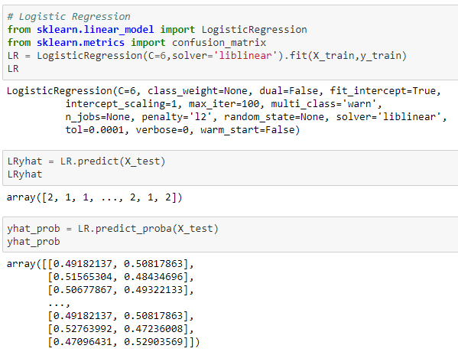
Modelling & Predictions (cont.)
Linear Regression

Slide 8
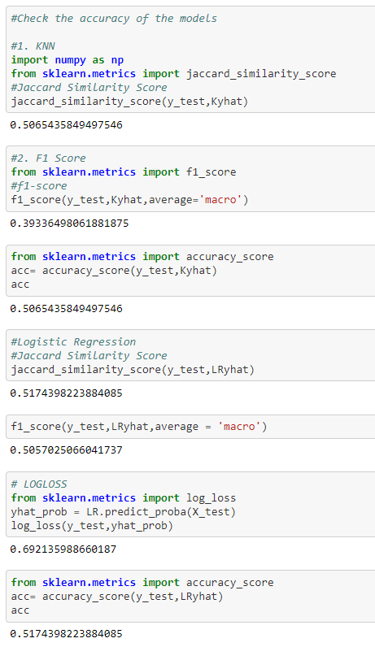
Result & Evaluation

Slide 9
Discussion
Dataset provide is categorical data which is type 'object’. In order to carry the analysis using algorithm, label encoding is utilize to convert the data ‘object’ type to ‘numerical’ type.
Datasets provided is also imbalanced. As observed, SEVERITYCOD=1 was more than 2 times larger than SEVERITYCOD=2. Downsampling the majority class with sklearn's resample tool id used to the minority class exactly with 57052 values each.
After the data is processed, they were analyze using ML models; K-Nearest Neighbor and Logistic Regression. In this case, logistic regression is best used because of its binary nature.
Evaluation metrics used to test the accuracy of our models were jaccard index, f-1 score and log loss for logistic regression. Choosing different k and C values helped to improve the accuracy of the model.

Slide 10
Conclusion
Based on historical data from weather conditions is the main factor that contribute to the different category of SEVERITYCODE.

